Slide 1
Tracking Technologies: An Examination of Hospital Privacy Compliance and IT System Control Effectiveness
Hilal Atasoy
Ryan McDonough
Guangyue (Maria) Zhang
Rutgers Business School

Slide 2
Notes
Laws and regulations: golden standards of privacy practice – GDPR
Incidents still occur: statistics of breach from privacy clearing house (privacy breach)
Hospitals are required by federal law to protect patient data – HIPPA (hold the data broker the same standard of data sharing practice)
hospitals may be sharing sensitive patient information through pixels installed on their websites (The Markup 2022)
A pixel is a small piece of code inserted into a website’s HTML or JavaScript code that can track user activity on the website. Pixels are widely used for ad targeting and to measure the effectiveness of marketing campaigns. – privacy economics
send information to companies such as Meta, Google, and Twitter, among others, which many argue may violate the Health Insurance Portability and Accountability Act (HIPAA) of 1996.
examine the use of pixels by U.S. hospitals and the outcome of poor privacy practice
Hospital Compliance and Internal Control Systems
Consequences: privacy concerns in healthcare could lead to decline in patient seeking professional care, hospital revenue/legal consequences
Notes:
The misconception in prior literature: sensitive information
summary law literature have little relevance to the accounting and auditing profession
submission literature review JIS publication research-oriented not for auditors to better understand
Current version is focused on the literature review on different cybersecurity and privacy policies. Mention on the beginning that your ultimate objective is to develop this paper to compare the deterrent effect of these policies in a multinational level (also how this affects the auditors activities).
Mention that the existing literature focuses on 1) only on the academic researches rather than the policies and 2) only on specific regions (EU or US) and do not compare between those. Also, this will be the first study that discusses the audit practitioner’s role on cybersecurity.
Make sure that when you show the tables, make it visible to the audiences. If it is too small, explain it in details.
Cybersecurity and Privacy are similar but different topics. Make sure to distinguish those two.
If someone asks you a question and if you are not sure, the best way is just to say”it was a good question, I will think about it.”
Make sure to bring a note and take a memo of the questions you received

Slide 3
Background - Consumer privacy
There is growing tension between ethical issues and a firm’s economic interest raised by big data analytics and behavioral analysis that violates public norms for acceptable data use
Consumer privacy protection regulations are essential to the change in privacy management practice
EU General Data Protection Regulation (GDPR)
Proposed - 2012, agreed upon - December 2016, in effect - May 25, 2018
The scope, timing, means of enforcement, and business obligations
What’s new
On 04th January 2023, Ireland's Data Protection Commission fined Meta 390 million euros for breaches of the GDPR relating to its social media service
The platforms’ basis for seeking user permission to collect data for personalized advertising is invalid
Notes:
EU Parliament and Council
Safe Web Act
Payment Ca
rd Industry Data Security Standard (PCI DSS)
confidentiality, integrity, and availability

Slide 4
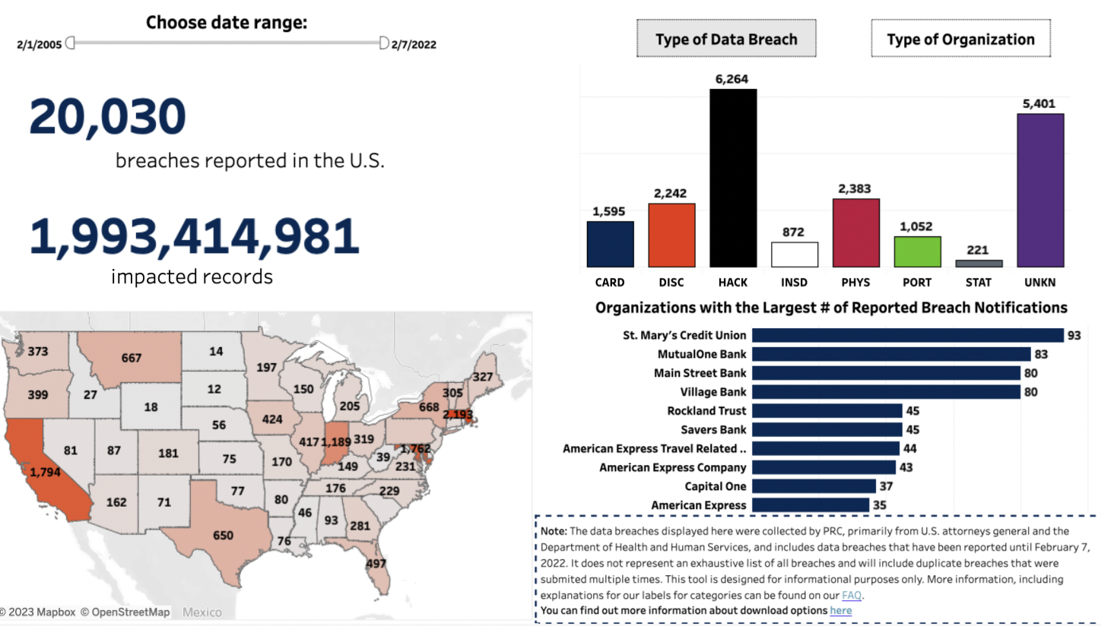
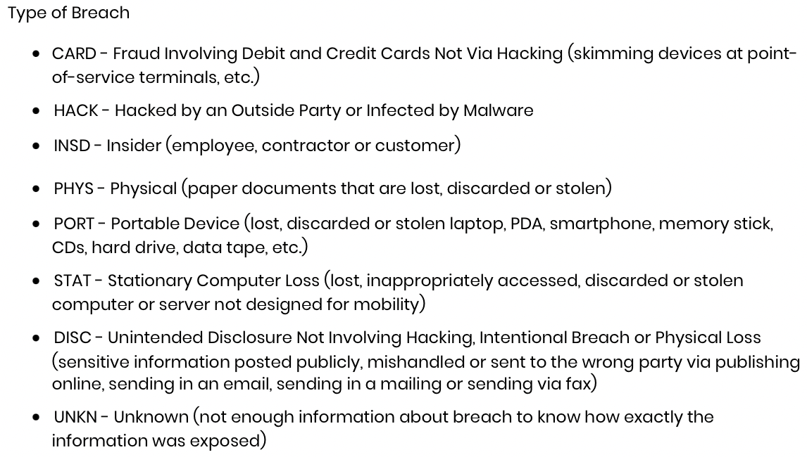
Background - Consumer privacy
Privacyrights clearinghouse:
Notes:
Safe Web Act
Payment Ca
rd Industry Data Security Standard (PCI DSS)
confidentiality, integrity, and availability

Slide 5
Background – Tracking technology
It is a script or code on a website or mobile app used to gather information about users as they interact with the website or mobile app
User information is then analyzed by owners of the website or mobile app or third parties to profile users (e.g., IP address) and create insights about users’ online activities
Pro: improve user experience
Con: user profile and continuous tracking by third parties without patients’ knowledge or consent
The Meta Pixel collects sensitive health information and shares it with Facebook
Notes:
Safe Web Act
Payment Ca
rd Industry Data Security Standard (PCI DSS)
confidentiality, integrity, and availability

Slide 6
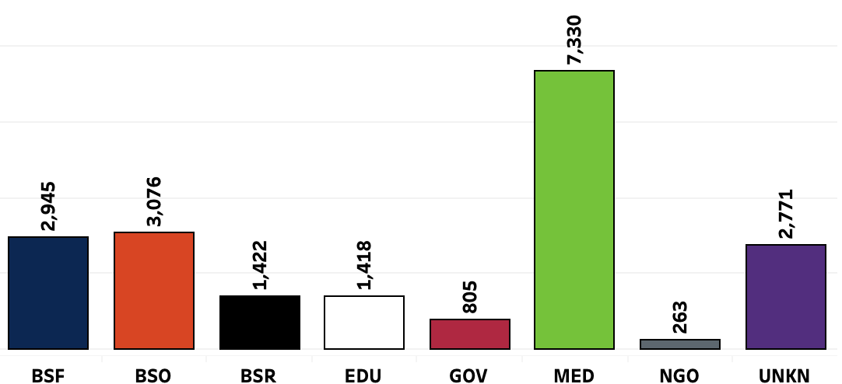
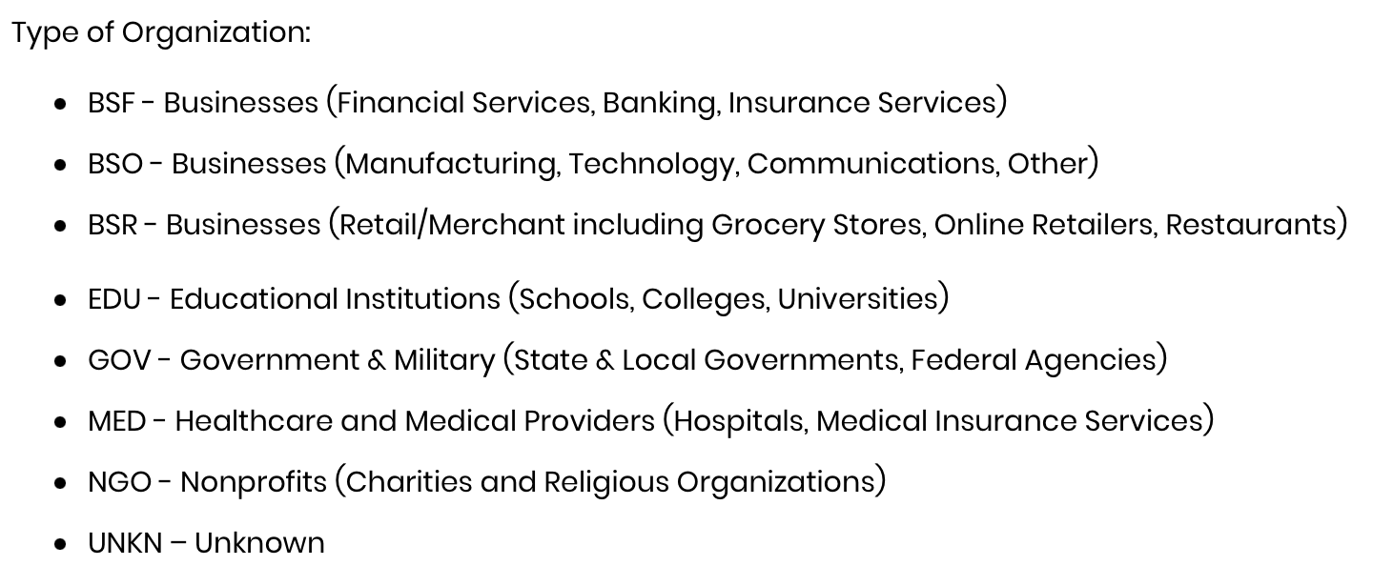
Background – Privacy breach
Privacyrights clearinghouse:
Notes:
Safe Web Act
Payment Ca
rd Industry Data Security Standard (PCI DSS)
confidentiality, integrity, and availability

Slide 7
Background - Consumer privacy
U.S. federal consumer privacy law - Health Insurance Portability and Accountability Act (HIPAA) of 1996
Objective: Designed to protect patients’ personal health information
Requirements: Obtaining authorization before use or disclosing, implement safeguards to protect the security health information
Components: Privacy rule, security rule, breach notification rule, and enforcement rule
Subject: entities(Healthcare providers, health plans, and healthcare clearinghouses) and business associates
U.S. Department of Health & Human Services
The HIPAA Rules apply when the information that regulated entities collect through tracking technologies or disclose to tracking technology vendors includes protected health information (PHI).
Regulated entities are not permitted to use tracking technologies in a manner that would result in impermissible disclosures of PHI to tracking technology vendors or any other violations of the HIPAA Rules.
Notes:
Safe Web Act
Payment Ca
rd Industry Data Security Standard (PCI DSS)
confidentiality, integrity, and availability

Slide 8
Research question
Q: Does impermissible data sharing increase information security vulnerability?
How do the HIPAA Rules apply to regulated entities’ use of tracking technologies?
Tracking on user-authenticated webpages
Tracking on unauthenticated webpages
Tracking within mobile apps
HIPAA compliance obligations for regulated entities when using tracking technologies
Regulated entities are required to comply with the HIPAA Rules when using tracking technologies.
Online tracking technology - poor information security awareness and possible poor practice by the hospital management
The markup article of 2022 “Facebook Is Receiving Sensitive Medical Information from Hospital Websites” shows many hospital management are not aware of the code insertion.
Even if there is a vetting process of the code, there is no disclosure on the rigor of the process
Notes:
EU Parliament and Council
Safe Web Act
Payment Ca
rd Industry Data Security Standard (PCI DSS)
confidentiality, integrity, and availability

Slide 9
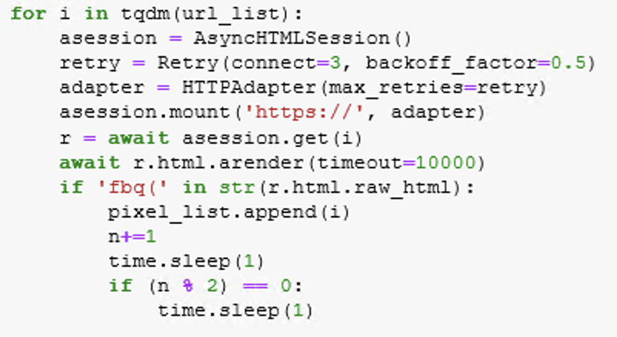
Data collection
Hospital pixel tracking history
US News hospital list and website URLs
Internet Archive Wayback Machine: retrieve historical website HTML and java script
Inspect retrieved code and script for “fbq() ” scripts
Final: 2010-2023 Hospital-year observation of pixel tracking usage
Notes:
EU Parliament and Council
Safe Web Act
Payment Ca
rd Industry Data Security Standard (PCI DSS)
confidentiality, integrity, and availability

Slide 10
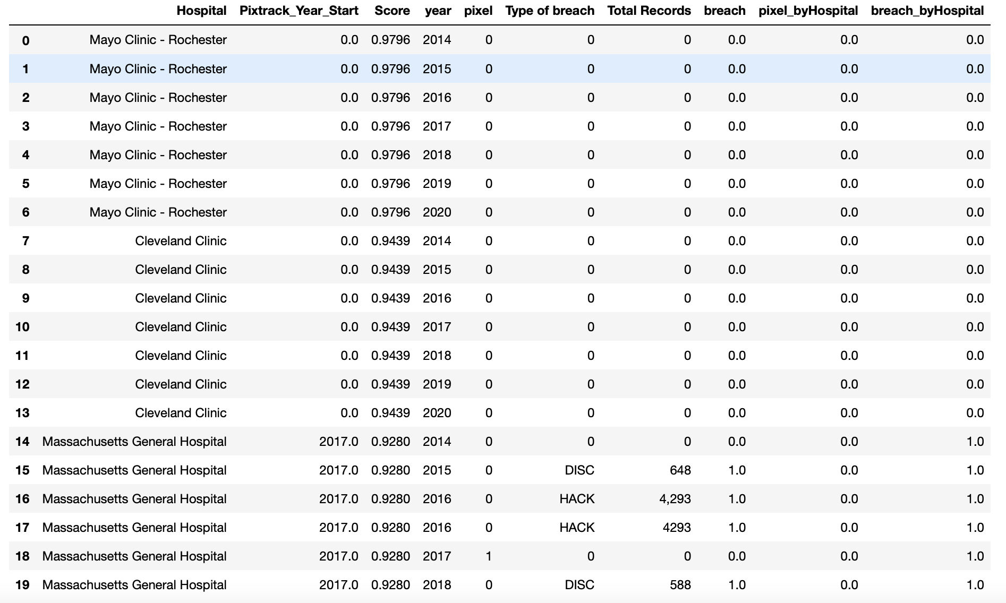
Data collection
Privacy breach
Privacyrights clearinghouse: breach chronology dataset, selecting “MED” organizations
Company name, Year of breach, Type of breach, Total Records, Date Made Public and description
Fuzzy matching of company name to merge the privacy breach dataset with the pixel tracking usage dataset
Final: 2010-2023 Hospital-year observation of pixel tracking usage indicator and breach incident indicator
Notes:
EU Parliament and Council
Safe Web Act
Payment Ca
rd Industry Data Security Standard (PCI DSS)
confidentiality, integrity, and availability

Slide 11
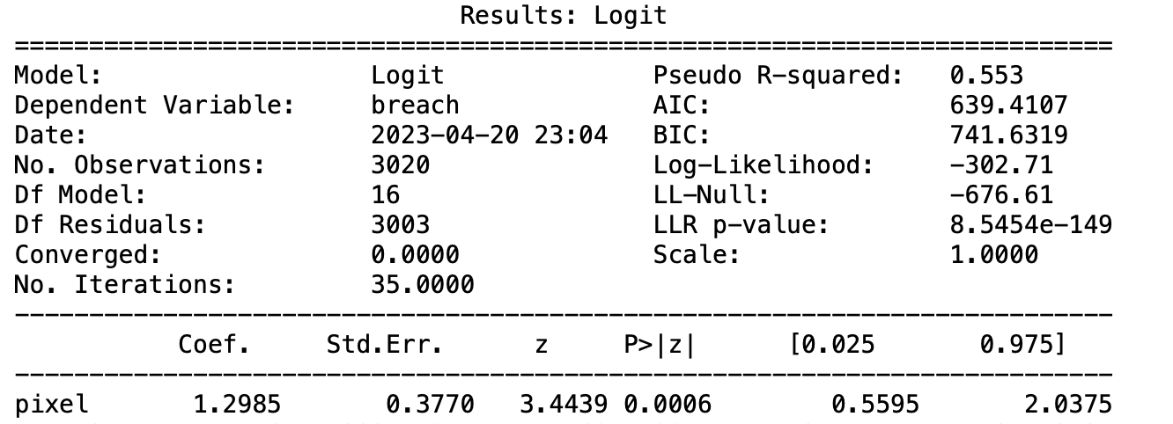
Results
Logit regression of pixel tracking usage indicator against privacy breach incident
Hospital and year fixed effects

Slide 12
Future plan of research
Explore the outcome of pixel tracking usage
Social welfare
Con: discrimination
Pro: community quality of life
Explore the determinants of pixel tracking usage
Centers for Medicare & Medicaid Services Data (CMS) dataset
Hospital profile (size, ownership, social responsibility, etc)
Cost report (Financial distress)
Market competition

Slide 13
Thanks for listening
gz132@scarletmail.rutgers.edu
13

